Slide 1
The Enhanced Entity-Relationship (EER) Model
Chapter - 2

Slide 2
Outline
Enhance ER or EER Diagrams
Review: Superclasses and Subclasses
When to use EER Modeling?
Subtype or Subclass of an entity type
Specialization and Generalization
Constraints on Specialization and Generalization
Specialization and Generalization Hierarchies and Lattices
Modeling of UNION Types Using Categories
Aggregation

Slide 3
EER diagrams
EER - stands for Extended ER (or) Enhanced ER model
Created to design more accurate database schemas
  Reflect the data properties and constraints more precisely
  Address more complex requirements
EER model - includes all the modeling concepts of the ER model
In addition, the concepts of
  Subclass and superclass and the related concepts of specialization and generalization
  Category or union type – used to represent a collection of objects (entities) that is the union of objects of different entity types
  Attribute and relationship inheritance
Notes:
These modeling constructs may allow more precise modeling of systems that are object-oriented in nature such as:
CAD/CAM systems (Computer-Aided Design/Manufacturing)
GIS (Geographical Information Systems)

Slide 4
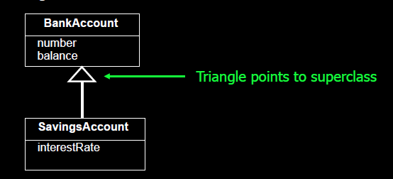
Review: Superclasses and Subclasses
A superclass is a general class that is extended by one or more subclasses
A subclass is a more specific class that extends a superclass by inheriting its methods and attributes and then adding its own methods and attributes
Inheritance is the process of a subclass inheriting all the methods and attributes of a superclass

Slide 5
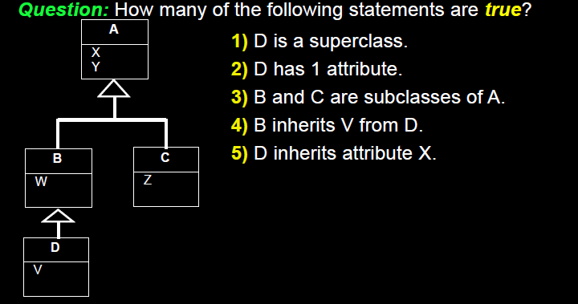
Review: Superclasses and Subclasses

Slide 6
When to use EER Modeling?
It is important to emphasize that many database projects do not need the Object-Oriented modeling features of EER Modeling
The goal of conceptual modeling is to produce a model that is simple and easy to understand
Do not include subclass/superclass relationships if they are not needed
Use EER Modeling constructs if they offer a significant advantage over regular ER modeling

Slide 7
When to use EER Modeling?
EER Modeling - useful when the domain being modeled is object oriented in nature and the use of inheritance reduces the complexity of the design
Two common cases where EER modeling is useful instead of basic ER modeling
  1) When using attribute inheritance can reduce the use of nulls in a single entity relation (that contains multiple subclasses)
    Attribute Inheritance - The attributes of the higher-level entity sets are said to be inherited by the lower-level entity sets
  2) Subclasses can be used to explicitly model and name subsets of entity types that participate in their own relationships

Slide 8
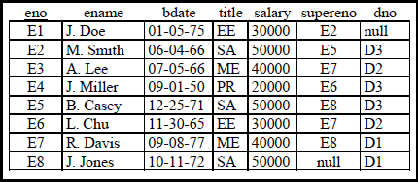
When to use EER Modeling?
Consider the Employee Relation
The title attribute indicates what job the employee does at the company. Consider if each job title had its own unique information that we would want to record such as:
  EE, PR-programming language used (lang), DB used (db)
  SA, ME-MBA? (MBA), bonus

Slide 9
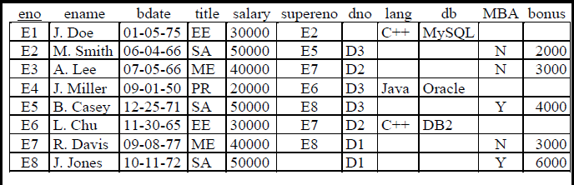
When to use EER Modeling?
We could represent all these attributes in a single relation
Note the wasted space as attributes that do not apply to a particular subclass are NULL

Slide 10
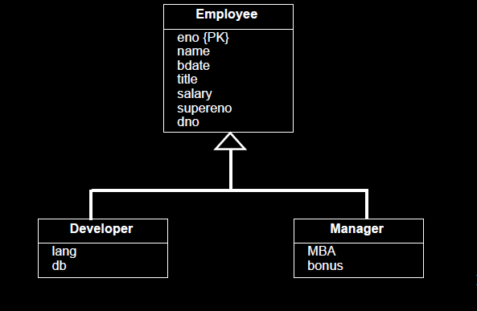
When to use EER Modeling?
A better solution would be to make two subclasses of Employee called Developer and Manager

Slide 11
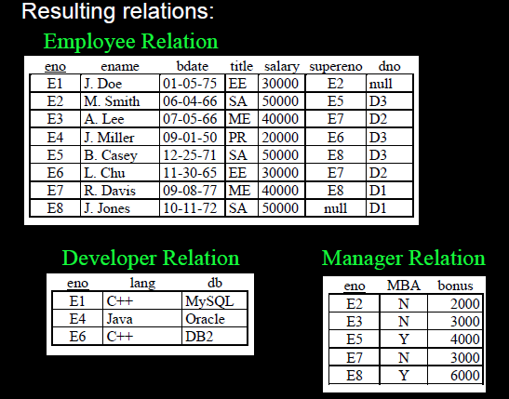
When to use EER Modeling?

Slide 12
Subtype or Subclass of an Entity type
In ER diagram, an entity type represents all entities underneath it
  Example : “ Employee” represents all entities of employees
Sometimes, entities underneath an entity type can be classified in to specific entities which have its own characteristics
  Example : Salaried employee, Hourly employee, Manager, Secretary, Engineer, Technician
  All these entity types are considered employees, but each has its own unique attributes

Slide 13
Subtype or Subclass of an Entity type
Salaried employee, Hourly employee, Manager, Secretary, Engineer, Technician – Subclasses of Employee
Employee - the Superclass of all previous types of employees
Inheritance - The connection between subclass and superclass
A subclass inherits all attributes of its superclass
An entity type is classified into subclasses because each subclass has its own unique attributes
  Example
    Secretaty has typing speed attribute
    Salaried-employee has salary attribute
    Hourly employee has pay scale attribute
    Engineer has eng_type attribute
    Technician has Tech-Grade attribute

Slide 14
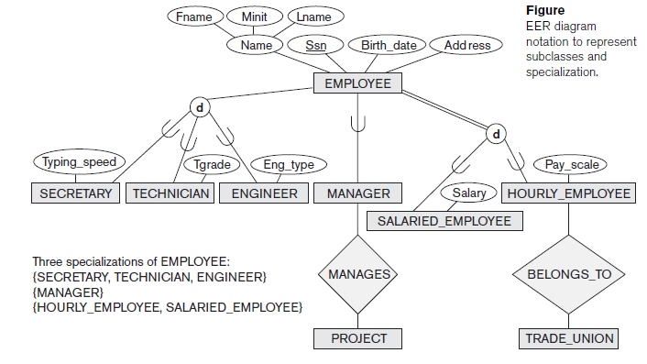
Subtype or Subclass of an Entity type

Slide 15
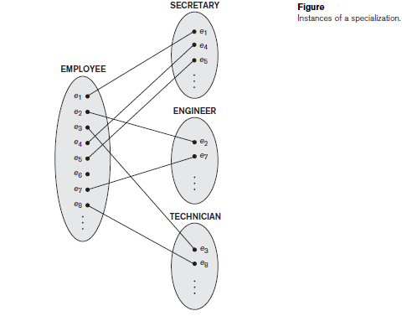
Subtype or Subclass of an Entity type

Slide 16
Subtype or Subclass of an Entity type
The entities that are members of the EMPLOYEE entity type may be distinguished further into
  SECRETARY
  ENGINEER
  MANAGER
  TECHNICIAN
  SALARIED_EMPLOYEE
  HOURLY_EMPLOYEE, and so on
Every entity that is a member of one of these subgroupings is also an employee

Slide 17
Subtype or Subclass of an Entity type
Subgroupings - a subclass or subtype of the EMPLOYEE entity type
EMPLOYEE entity type - superclass or supertype for each of these subclasses
Relationship between a superclass and any one of its subclasses - A superclass/subclass or supertype/subtype or simply class/subclass relationship
A class/subclass relationship is often called an IS-A (or IS-AN) relationship because of the way we refer to the concept.
  We say a SECRETARY is an EMPLOYEE, a TECHNICIAN is an EMPLOYEE, and so on
  Example, EMPLOYEE/SECRETARY and EMPLOYEE/TECHNICIAN are two class/subclass relationships

Slide 18
Subtype or Subclass of an Entity type
Implementation of a superclass/subclass relationship in the database system
A member of the subclass is a distinct database object - say, a distinct record that is related via the key attribute to its superclass entity
An entity cannot exist in the database merely by being a member of a subclass - it must also be a member of the superclass
  Such an entity can be included optionally as a member of any number of subclasses
    For example, a salaried employee who is also an engineer belongs to the two subclasses ENGINEER and SALARIED_EMPLOYEE of the EMPLOYEE entity type
It is not necessary that every entity in a superclass is a member of some subclass

Slide 19
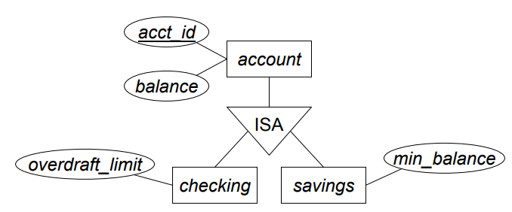
Subtype or Subclass of an Entity type
An entity that is a member of a subclass inherits all the attributes of the entity as a member of the superclass
The entity also inherits all the relationships in which the superclass participates
  Notice that a subclass, with its own specific (or local) attributes and relationships together with all the attributes and relationships it inherits from the superclass, can be considered an entity type in its own right

Slide 20
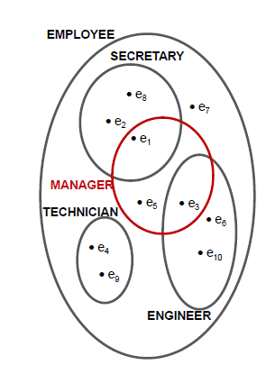
Subtype or Subclass of an entity type
Every technician/secretary/engineer is an employee
Not every employee of superclass must be in a subclass
All properties of employee (attributes and relationships) are inherited by specialized subclasses
Specialized entities might have additional attributes and be involved in additional relationships.
Subclasses may be disjoint or overlapping

Slide 21
Specialization and Generalization
Specialization - the process of defining a set of subclasses of an entity type
The set of subclasses that forms a specialization is defined on the basis of some distinguishing characteristic of the entities in the superclass
  For example, the set of subclasses {SECRETARY, ENGINEER, TECHNICIAN} is a specialization of the superclass EMPLOYEE that distinguishes among employee entities based on the job type of each employee entity
  Another specialization of the EMPLOYEE entity type may yield the set of subclasses {SALARIED_EMPLOYEE, HOURLY_EMPLOYEE}; this specialization distinguishes among employees based on the method of pay

Slide 22
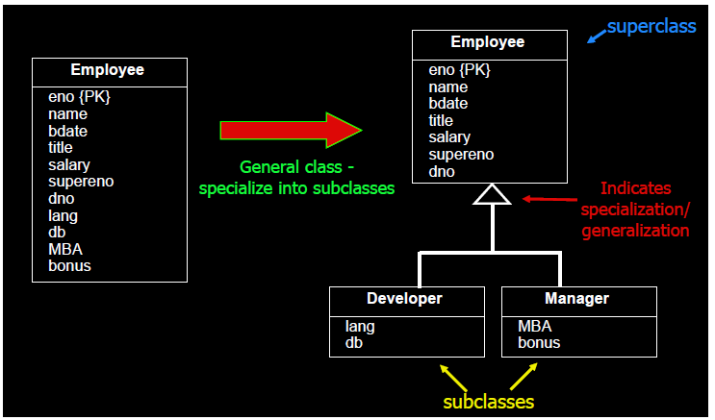
Specialization Example

Slide 23
Specialization and Generalization
Two main reasons for including class/subclass relationships and specializations in a data model
  1. Certain attributes may apply to some but not all entities of the superclass
    Example
    The SECRETARY subclass has the specific attribute Typing_speed The ENGINEER subclass has the specific attribute Eng_type
  2. Some relationship types may be participated in only by entities that are members of the subclass
    Example
    HOURLY_EMPLOYEES can belong to a trade union
      we can represent that fact by creating the subclass HOURLY_EMPLOYEE of EMPLOYEE and relating the subclass to an entity type TRADE_UNION via the BELONGS_TO relationship type

Slide 24
Specialization and Generalization
In summary, the specialization process allows us to do the following
  Define a set of subclasses of an entity type
  Establish additional specific attributes with each subclass
  Establish additional specific relationship types between each subclass and other entity types or other subclasses

Slide 25
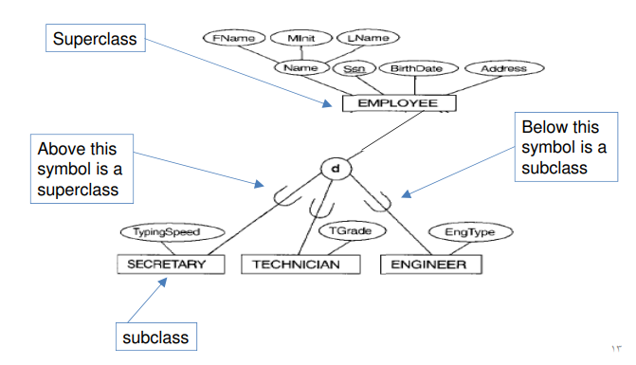
Specialization
How specialization is represented in EER?

Slide 26
Specialization
A specialization may also consist of a single subclass only, such as the {MANAGER} specialization - do not use the circle notation

Slide 27
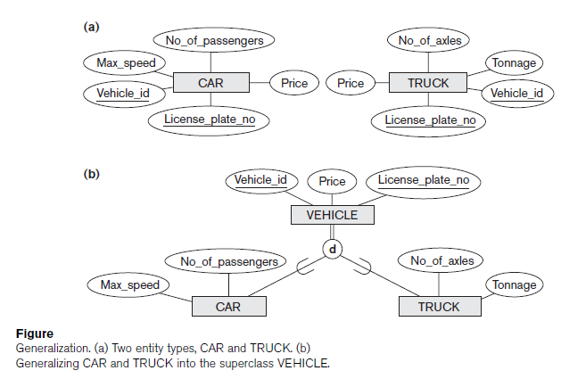
Generalization
Generalization – suppresses the differences among several entity types, identify their common features, and generalize them into a single superclass of which the original entity types are special subclasses
Generalization process is functionally the inverse of the specialization process
Superclass
Subclasses

Slide 28
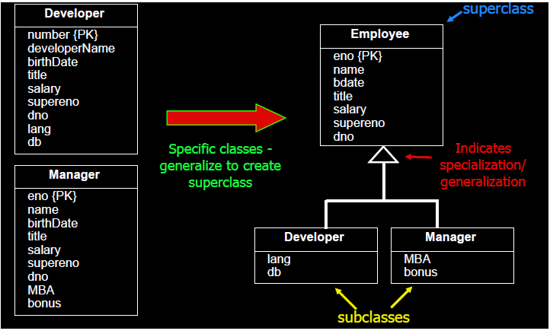
Generalization Example

Slide 29
Constraints on Specialization and Generalization
Based on Definition
  1) predicate Defined Subclasses
  2) user defined subclasses
Based on membership
  1) Disjoint subclasses
  2) Overlapping subclasses
Based on completeness of Participation
  1) Total Specialization
  2) Partial Specialization

Slide 30
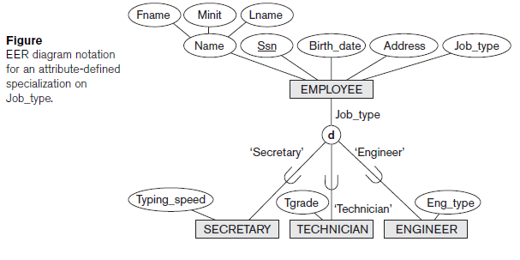
Constraints on Specialization and Generalization
Predicate-defined (or condition-defined) subclasses
  To determine exactly the entities that will become members of each subclass by placing a condition on the value of some attribute of the superclass
(Job_type = ‘Secretary’)
(Defining Predicate)

Slide 31
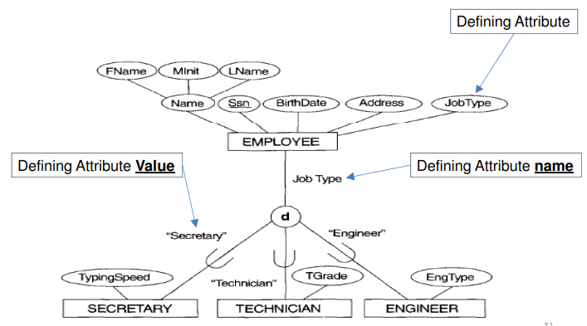
Predicate Defined Subclasses

Slide 32
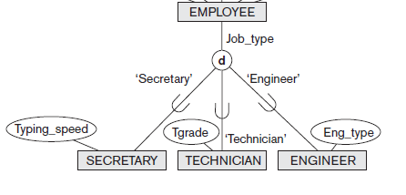
Constraints on Specialization and Generalization
If all subclasses in a specialization have their membership condition on the same attribute of the superclass, the specialization itself is called an attribute-defined specialization
The attribute is called the defining attribute of the specialization
In this case, all the entities with the same value for the attribute belong to the same subclass
An attribute-defined specialization - displayed by placing the defining attribute name next to the arc from the circle to the superclass

Slide 33
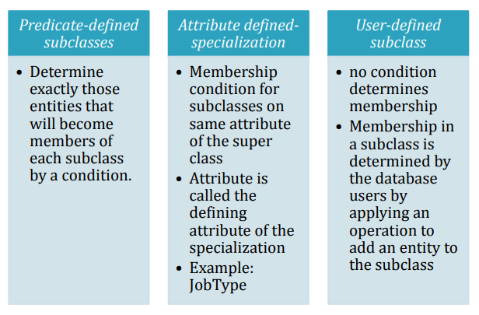
Constraints on Specialization and Generalization
When we do not have a condition for determining membership in a subclass, the subclass is called user-defined
  Membership in such a subclass is determined by the database users

Slide 34
Constraints on Specialization and Generalization
Two other constraints may apply to a specialization (Subclasses) (Based on Membership)
1. Disjointness (or disjointedness) constraint
  specifies that the subclasses of the specialization must be disjoint
  This means that an entity can be a member of at most one of the subclasses of the specialization
A specialization that is attribute-defined implies the disjointness constraint (if the attribute used to define the membership predicate is single-valued)
In EER, ‘d’ in the circle stands for disjoint

Slide 35
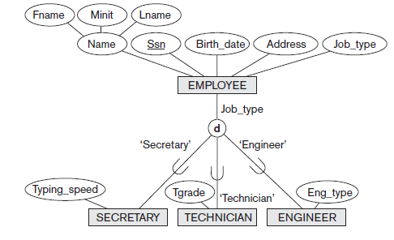
Disjointness Constraint
“d” stands for Disjoint

Slide 36
Disjointness Constraint
Question: If a specialization is “attribute-defined”, does this mean that it is a “disjoint” specialization?
Answer: If the defining attribute is
  Single -Valued: then, the answer is “yes”
  Multi-valued: then, the answer is “No”

Slide 37
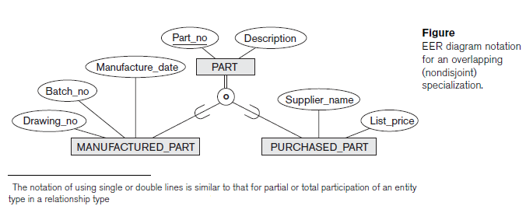
Overlapping Subclasses
‘d’ notation - also applies to user-defined subclasses of a specialization that must be disjoint
If the subclasses are not constrained to be disjoint, their sets of entities may be overlapping
  the same (real-world) entity may be a member of more than one subclass of the specialization
  This case is displayed by placing an ‘o’ in the circle
“o” stands for overlapping

Slide 38

Constraints on Specialization and Generalization
Overlapping – employee and student
Disjoint – instructor and secretary
Silberschatz

Slide 39
Constraints on Specialization and Generalization
2. Completeness (or totalness) constraint - Total or Partial (Based on completeness of Participation)
  Total specialization - constraint specifies that every entity in the superclass must be a member of at least one subclass in the specialization
  For example : if every EMPLOYEE must be either an HOURLY_EMPLOYEE or a SALARIED_EMPLOYEE, then the specialization {HOURLY_EMPLOYEE, SALARIED_EMPLOYEE} is a total specialization of EMPLOYEE
Total Specialization – Represented in EER diagrams by using a double line to connect the superclass to the circle
Partial specialization - A single line is used, which allows an entity not to belong to any of the subclasses

Slide 40
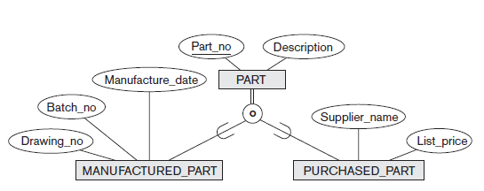
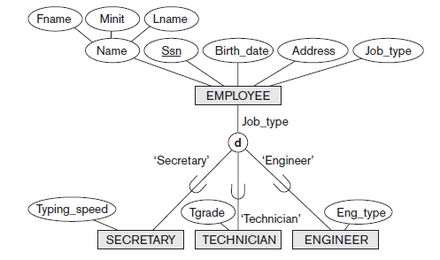
Total and Partial Specialization
Total Specialization
Partial Specialization

Slide 41
Constraints on Specialization and Generalization - Note
The disjointness and completeness constraints are independent
Four possible constraints on specialization
  Disjoint, total
  Disjoint, partial
  Overlapping, total
  Overlapping, partial

Slide 42
Example
Example of Disjoint Partial Specialization

Slide 43
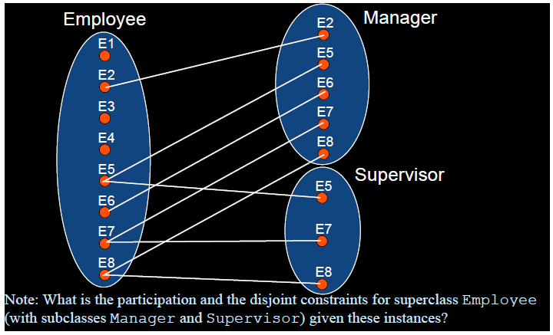
Question

Slide 44
Specialization and Generalization Hierarchies and Lattices
A subclass itself may have further subclasses specified on it, forming a hierarchy or a lattice of specializations
A specialization hierarchy has the constraint that every subclass participates as a subclass in only one class/subclass relationship
  ie., , each subclass has only one parent, which results in a tree structure or strict hierarchy
A specialization lattice, a subclass can be a subclass in more than one class/subclass relationship

Slide 45
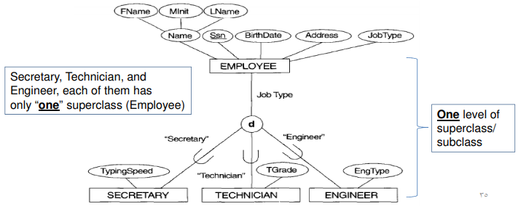
Specialization and Generalization Hierarchies and Lattices

Slide 46
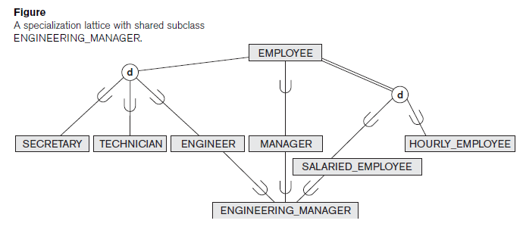
Specialization and Generalization Hierarchies and Lattices
Two levels of subclass/superclass
Direct Super Classes
Here, we have 2 levels Of superclass/subclass connections

Slide 47
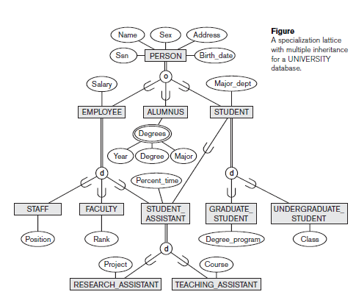
Specialization Lattice of more than One Level

Slide 48
Specialization Lattice of more than One Level
All person entities represented in the database are members of the PERSON entity type, which is specialized into the subclasses {EMPLOYEE, ALUMNUS, STUDENT}
This specialization is overlapping; for example, an alumnus may also be an employee and may also be a student pursuing an advanced degree
The subclass STUDENT is the superclass for the specialization {GRADUATE_STUDENT, UNDERGRADUATE_STUDENT}, while EMPLOYEE is the superclass for the specialization {STUDENT_ASSISTANT, FACULTY, STAFF}.
STUDENT_ASSISTANT is the superclass for the specialization into {RESEARCH_ASSISTANT, TEACHING_ASSISTANT}

Slide 49
Specialization Lattice of more than One Level
In specialization lattice or hierarchy, a subclass inherits the attributes not only of its direct superclass, but also of all its predecessor superclasses all the way to the root of the hierarchy or lattice if necessary
For example, an entity in GRADUATE_STUDENT inherits all the attributes of that entity as a STUDENT and as a PERSON
A subclass with more than one superclass is called a Shared Subclass- Multiple Inheritance
  For example, ENGINEERING_MANAGER
Leaf Node: A class that has no subclasses of its own

Slide 50
Specialization Lattice of more than One Level
An important rule related to Multiple Inheritance
Consider the subclass STUDENT_ASSISTANT which inherits attributes from both EMPLOYEE and STUDENT
Both EMPLOYEE and STUDENT inherit the same attributes from PERSON
The rule states that if an attribute (or relationship) originating in the same superclass (PERSON) is inherited more than once via different paths (EMPLOYEE and STUDENT) in the lattice, then it should be included only once in the shared subclass (STUDENT_ASSISTANT)
PERSON
EMPLOYEE
STUDENT
STUDENT_ASSISTANT

Slide 51
Refining Conceptual Schemas
Subclasses and superclasses are created by using either Generalization or Specialization
Specialization - the process of creating more specialized subclasses of an existing superclass
Top-down conceptual refinement - Start with a general class and then subdivide it into more specialized classes
  The specialized classes may contain their own attributes. Attributes common to all subclasses remain in the superclass
Generalization - is the process of creating a more general superclass from existing subclasses
  Bottom-up conceptual synthesis : Start with specialized classes and try to determine a general class that contains the attributes common to all of them

Slide 52
Modeling of UNION Types Using Categories
All of the superclass/subclass relationships we have seen thus far have a single superclass
In some cases, we need to model a single superclass/subclass relationship with more than one superclass
Superclasses can represent different entity types
A union type or a category - the subclass will represent a collection of objects that is a subset of the UNION of distinct entity
Example: In a database for vehicle registration, a vehicle owner can be a PERSON, a BANK (holding a lien on a vehicle) or a COMPANY
  A category (UNION type) called OWNER is created to represent a subset of the union of the three superclasses COMPANY, BANK, and PERSON
  A category member must exist in at least one of its superclasses

Slide 53
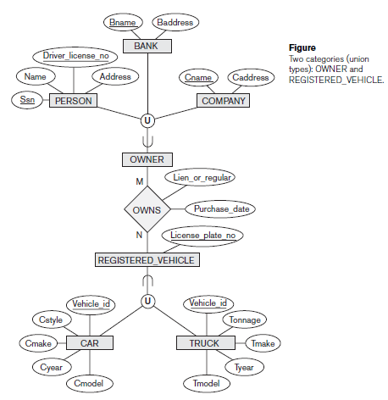
Modeling of UNION Types Using Categories

Slide 54
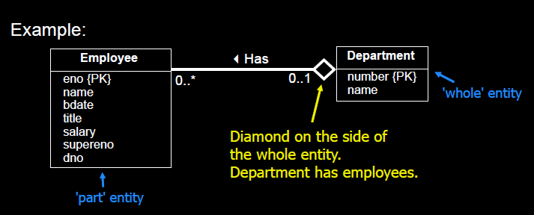
Review: Aggregation
Represents a 'HAS-A‘ or 'IS-PART-OF‘ relationship between entity types.
One entity type is the whole, the other is the part

Slide 55
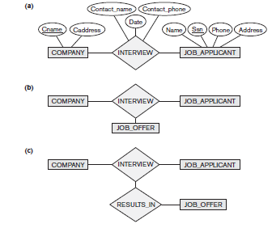
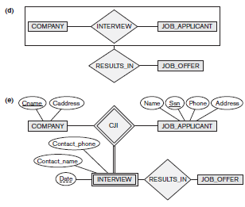
Aggregation
One limitation of the E-R model is that it cannot express relationships among relationships
Aggregation is an abstraction through which relationships are treated as higher-level entities

Slide 56
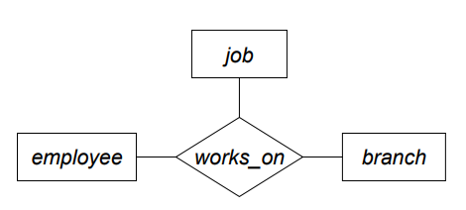
Aggregation
Basic E-R model can’t represent relationships involving other relationships
Want to assign a manager to each (employee, branch, job) combination
Need a separate manager entity-set – Relationship between each manager, employee, branch, and job entity

Slide 57
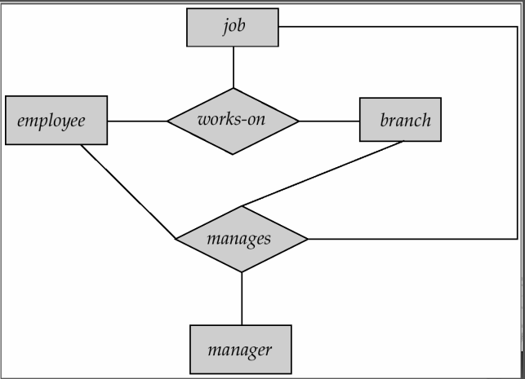
Aggregation
Consider the ternary relationship works-on
Suppose we want to record managers for tasks performed by an employee at a branch

Slide 58
Aggregation
Relationship sets works-on and manages represent overlapping information
  Every manages relationship corresponds to a works-on relationship
  However, some works-on relationships may not correspond to any manages relationships
  So we can’t discard the works-on relationship
Eliminate this redundancy via aggregation
  Treat relationship as an abstract entity
  Allows relationships between relationships
  Abstraction of relationship into new entity
Without introducing redundancy, the following diagram represents
    An employee works on a particular job at a particular branch
    An employee, branch, job combination may have an associated manager

Slide 59
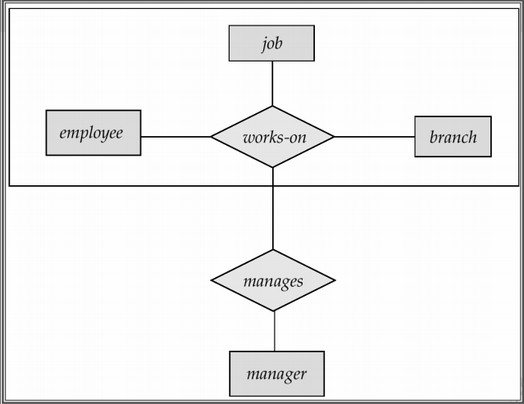
Aggregation

Slide 60
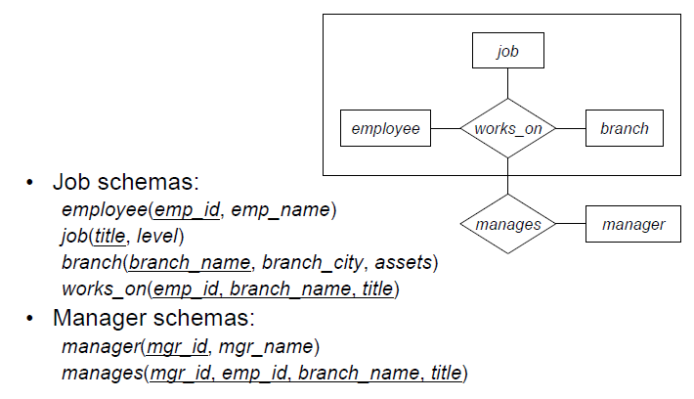
Aggregation

Slide 61
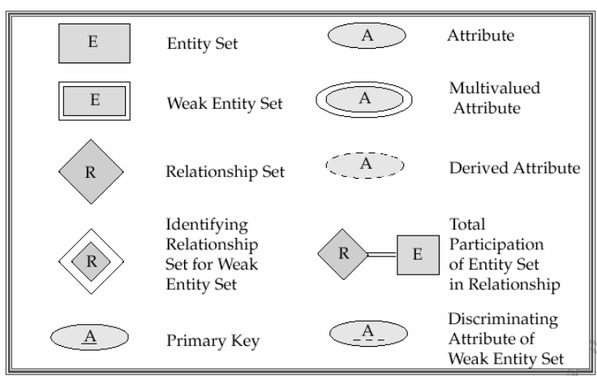
Summary of Symbols Used in ER

Slide 62
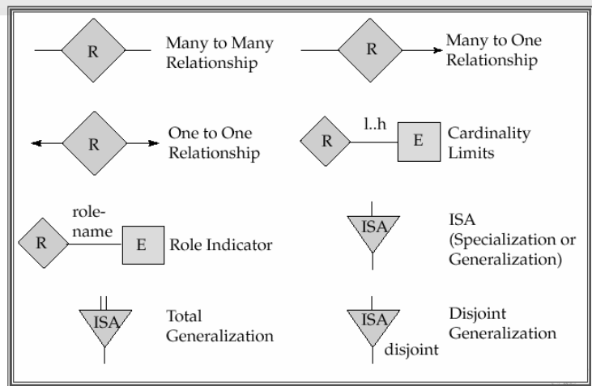
Summary of Symbols Used in ER

Slide 63
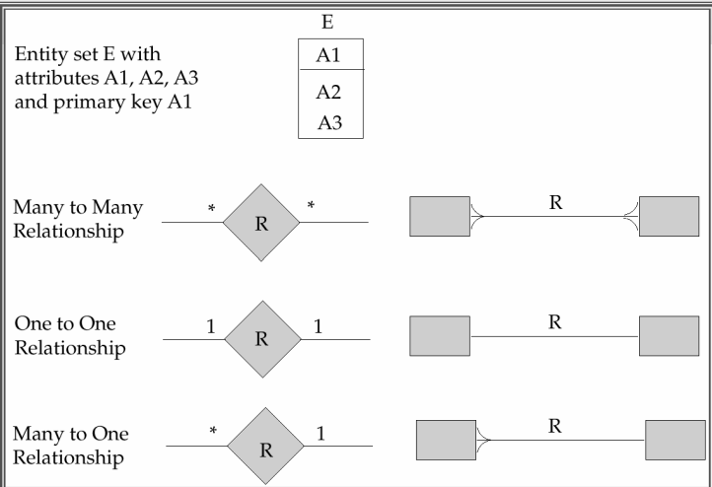
Alternative E-R Notations

Slide 64
EER
Enhanced Entity-Relationship model (EER) model allows for object-oriented design features to be captured
Generalization and specialization are two complementary processes for constructing superclasses and subclasses
Overlapping and disjoint constraints apply to subclasses
Aggregation is used to model HAS-A or PART-OF relationships
These features are rarely needed in most database design projects

